Slide 1
For Farmer, For Future Presentation
팀원: 문영재
이소라
문동민

Slide 2
INDEX
Model
(DeepLearning)
Reason
Q&A
Design Specification
Web Service

Slide 3
INDEX
Model
(DeepLearning)
Reason
Q&A
Design Specification
Web Service

Slide 4
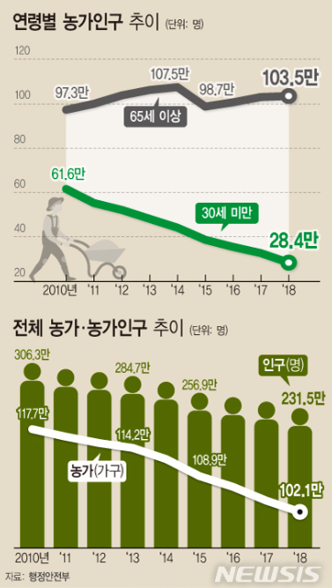
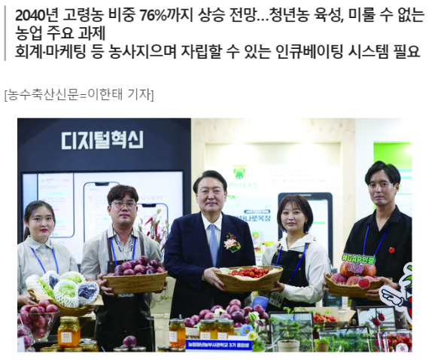
Reason

Slide 5
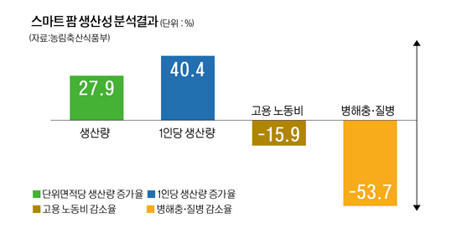
Reason
Notes:
https://www.palnews.co.kr/news/articleView.html?idxno=205376 https://www.womancs.co.kr/news/articleView.html?idxno=26732
https://www.snunews.com/news/articleView.html?idxno=32275
http://m.inhapress.com/news/articleView.html?idxno=11008
https://mobile.newsis.com/view.html?ar_id=NISX20190417_0000623422

Slide 6
INDEX
Model
(DeepLearning)
Reason
Q&A
Design Specification
Web Service

Slide 7








Environment
OS 및 개발 툴
데이터 분석 및 모델
웹 개발
Windows 10
Python 3.9.7
Numpy 1.23.5
Django 4.0.6
Colab pro+
Pandas 1.5.3
Tensorflow 2.15.0
Pycharm(23.3.1)
Pillow 9.4.0

Slide 8
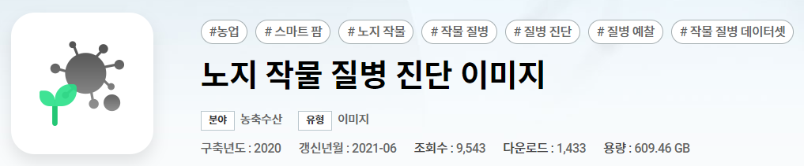

data
• Disease image data of major open field crops (10 types) for disease diagnosis of
open field crops
• Using 270,000 actual shots (240,000 normal, 30,000 diseased)
• Generate augmented data converted using various transform techniques based on
images classified as diseases(200,000 diseased)

Slide 9
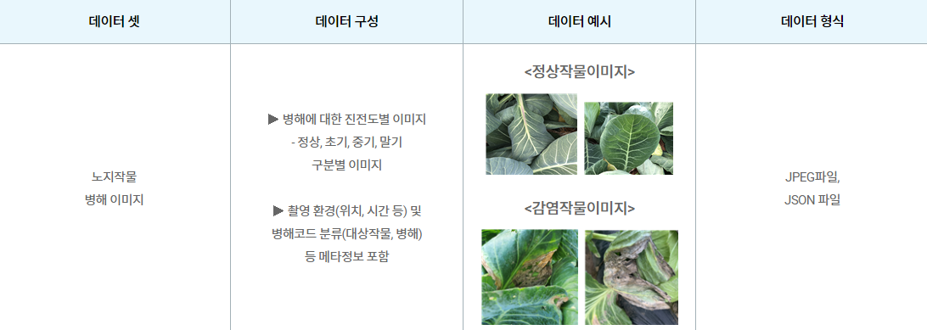
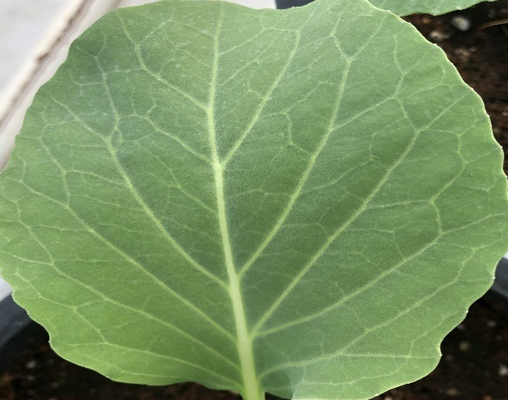
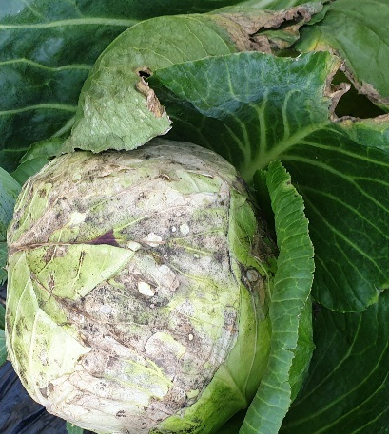
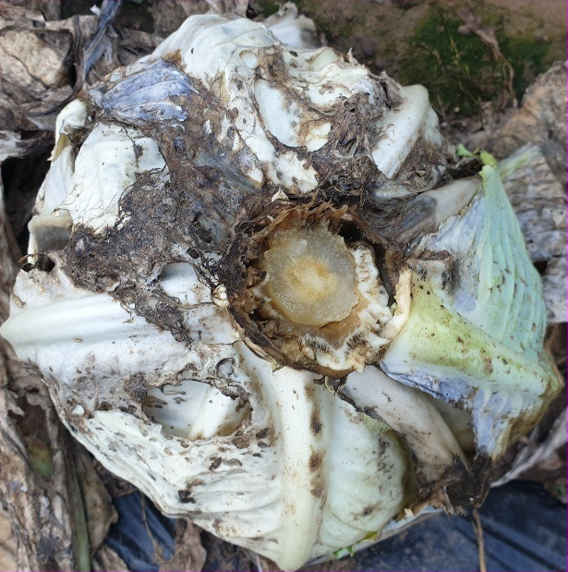
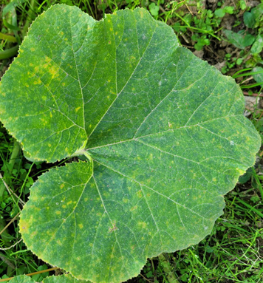
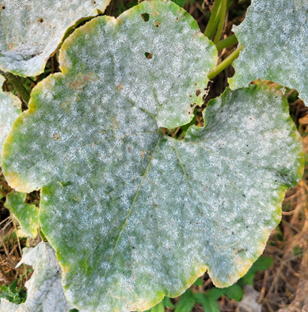
data

Slide 10
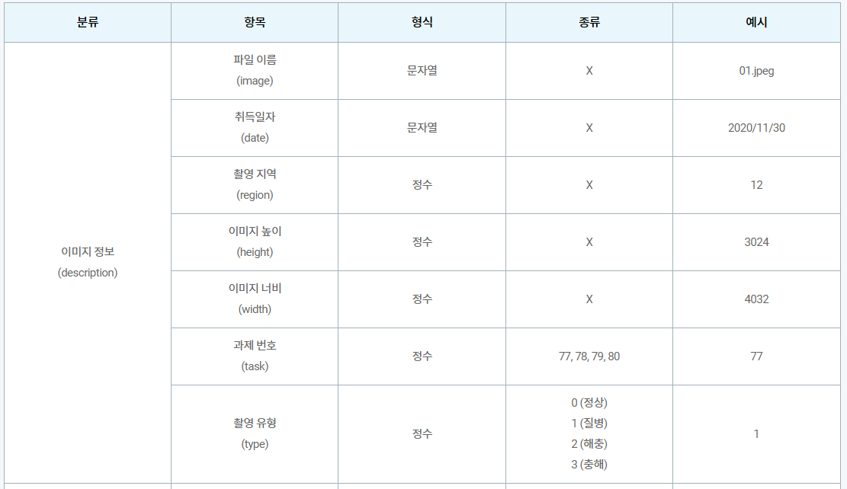
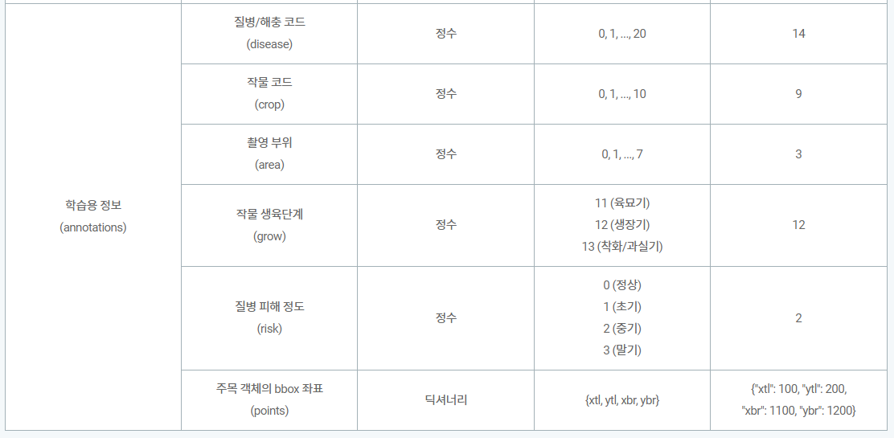
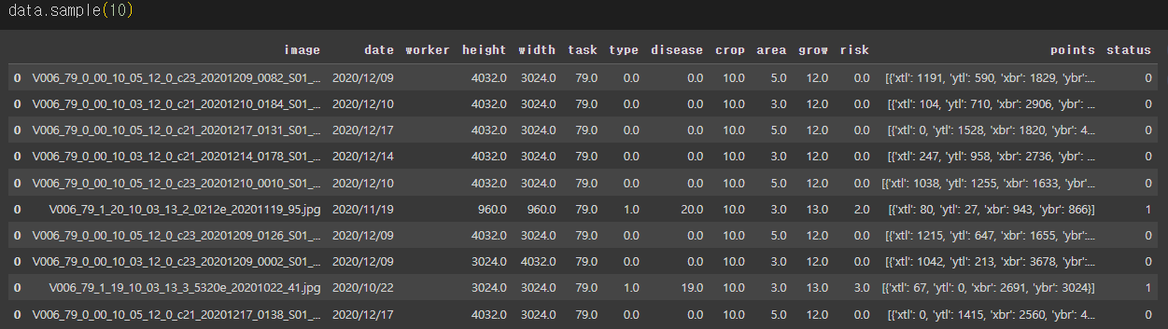
data

Slide 11

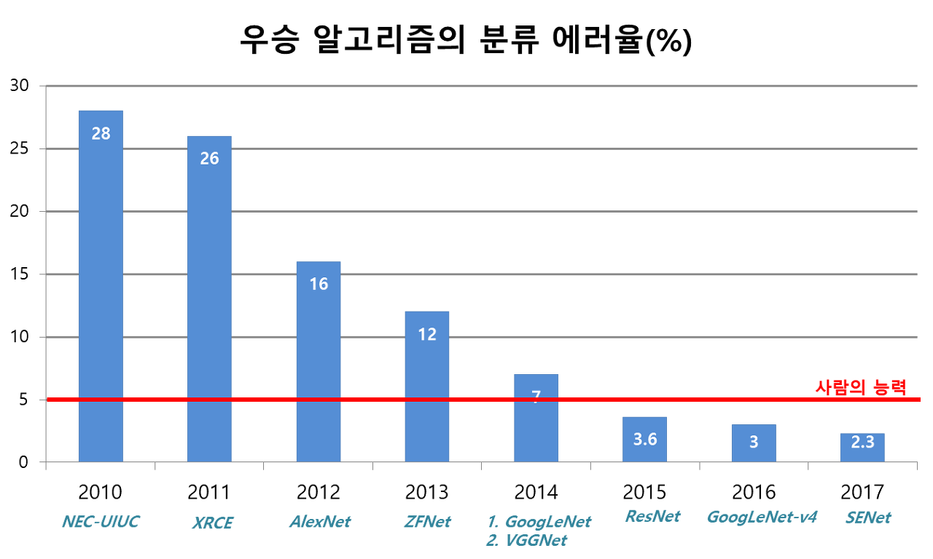
Model
Since 2010, the ImageNet project has been holding an annual software contest called the ImageNet ILSVRC (Large Scale Visual Recognition Challenge).
In this contest, software programs compete to correctly classify and detect objects and scenes.
This project is about image recognition and classification. From a model perspective, the goal is to identify plant diseases that are difficult to identify with the human eye through machine learning.
Therefore, it must satisfy the prerequisite of being superior to human discrimination ability.
ResNet, which has been trusted for a long time, seemed suitable.

Slide 12
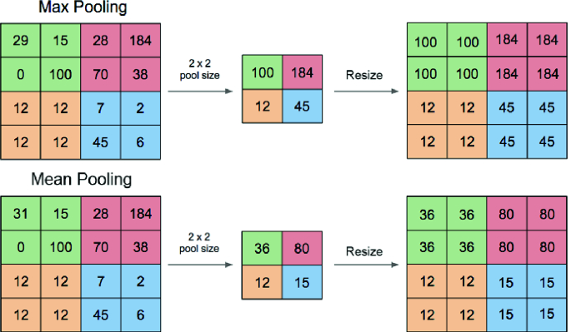
Model & Max Pool / Mean Pool

Slide 13
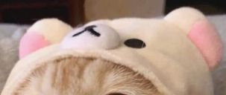
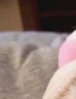
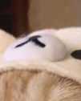
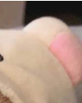

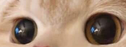
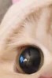
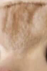
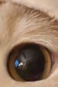
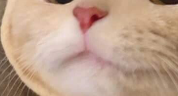
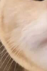
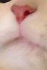
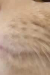
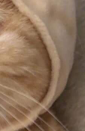
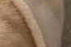
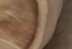

Model & Max Pool / Mean Pool
1 | 1 | 1
0 | 0 | 0
0 | 0 | 0
59 | 30 | 20 | 70 | 80 | 90 | 88
66 | 20 | 77 | 81 | 15 | 48 | 98
0 | 0 | 0 | 0 | 0 | 0 | 0
0 | 0 | 0 | 0 | 0 | 0 | 0
0 | 0 | 0 | 0 | 0 | 0 | 0
0 | 0 | 0 | 0 | 0 | 0 | 0
0 | 0 | 0 | 0 | 0 | 0 | 0
0 | 0 | 0
1 | 1 | 0
0 | 0 | 0
0 | 0 | 0 | 0 | 0 | 0 | 0
0 | 0 | 0 | 0 | 0 | 0 | 0
88 | 15 | 45 | 78 | 35 | 58 | 48
66 | 88 | 46 | 87 | 30 | 28 | 15
0 | 0 | 0 | 0 | 0 | 0 | 0
0 | 0 | 0 | 0 | 0 | 0 | 0
0 | 0 | 0 | 0 | 0 | 0 | 0
0 | 0 | 0
0 | 0 | 0
1 | 1 | 0
0 | 0 | 0 | 0 | 0 | 0 | 0
0 | 0 | 0 | 0 | 0 | 0 | 0
0 | 0 | 0 | 0 | 0 | 0 | 0
0 | 0 | 0 | 0 | 0 | 0 | 0
0 | 0 | 0 | 0 | 0 | 0 | 0
88 | 77 | 66 | 15 | 78 | 12 | 21
23 | 30 | 55 | 48 | 90 | 77 | 89
0 | 0 | 0
0 | 0 | 1
0 | 0 | 1
0 | 0 | 0 | 0 | 0 | 17 | 58
0 | 0 | 0 | 0 | 0 | 95 | 47
0 | 0 | 0 | 0 | 0 | 56 | 66
0 | 0 | 0 | 0 | 0 | 24 | 84
0 | 0 | 0 | 0 | 0 | 47 | 78
0 | 0 | 0 | 0 | 0 | 35 | 98
0 | 0 | 0 | 0 | 0 | 89 | 55
<Convolution(9x9)>
<Max Pool(2x2)>
<Mean Pool(2x2)>
Softmax

Slide 14
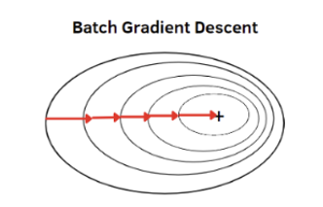
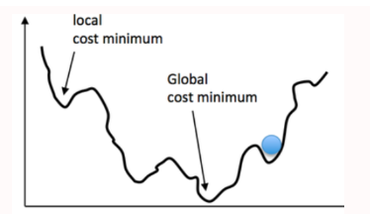
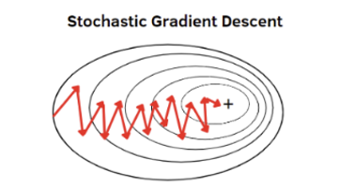
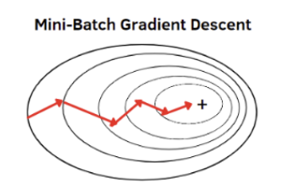
Model & Batch Normalization
Local minimum
Global minimum
Local minimum
Global minimum
Notes:
Global minimum찾을 확률 높은 mini batch

Slide 15
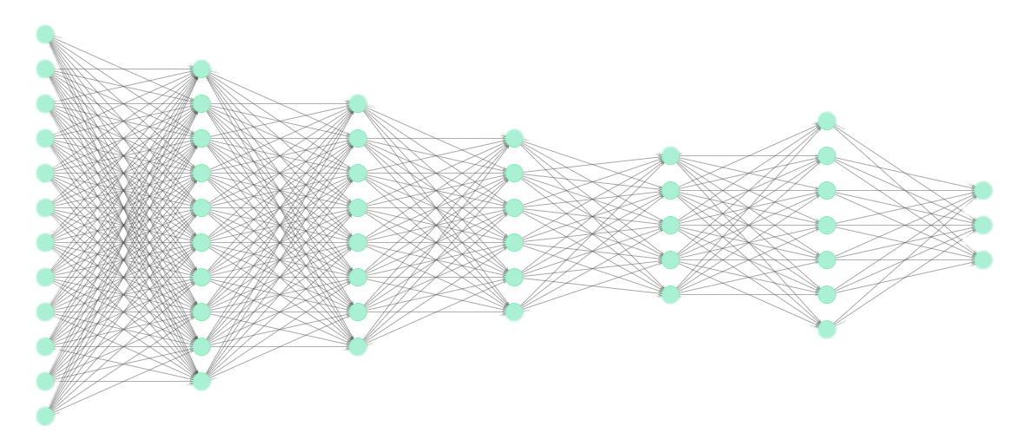
Model
All Neural Network Architecture
Softmax
Hidden Layer
(1000x1)
Output Layer
(3x1)
Convolution Layer
Fully Connected Layer

Slide 16
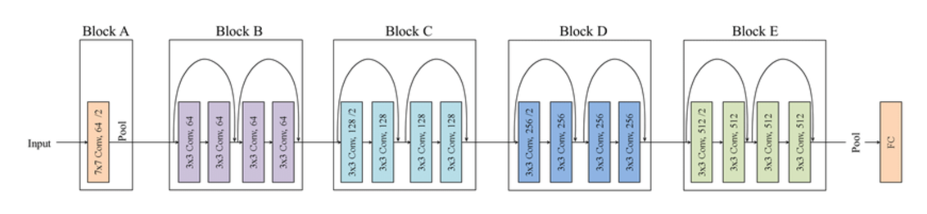
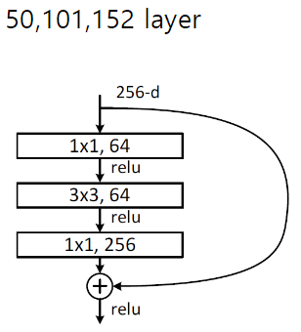
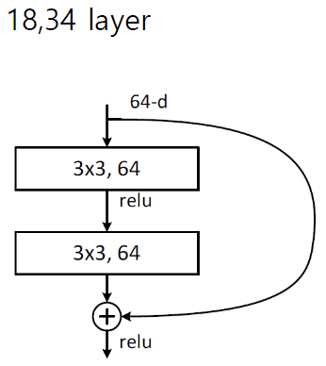
Model
ResNet18 Architecture

Slide 17
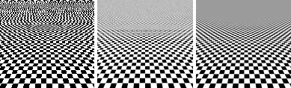
Filter
Anti-Aliasing
• When the sampling frequency is lower than twice the maximum frequency of the original signal, the
phenomenon in which adjacent spectra overlap and the output is distorted is called aliasing.
• This indicates that when playing rendered content, pixel fragments of the output image bounce, or
the edges of lines or shapes become rough and sharp

Slide 18
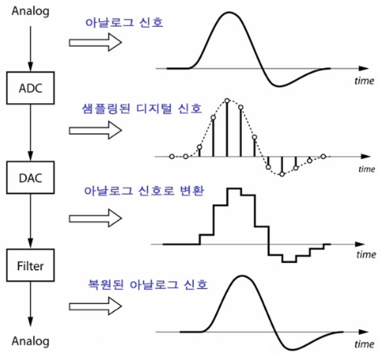
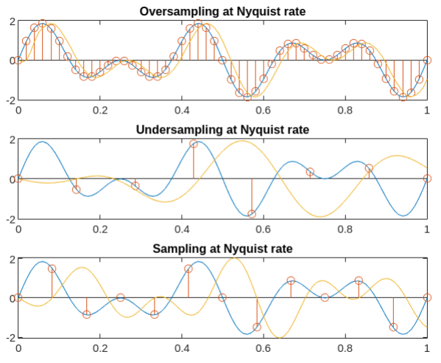
Filter
Anti-Aliasing

Slide 19
INDEX
Model
(DeepLearning)
Reason
Q&A
Design Specification
Web Service

Slide 20
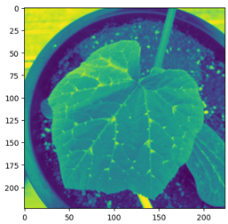
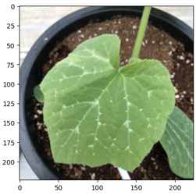
Data Preprocessing
length = X_train.shape[0]
gray_images = []
for i in range(length):
img = X_train[i]
height = img.shape[0]
width = img.shape[1]
gray_image = np.zeros((height, width), dtype=np.uint8)
for h in range(height):
for w in range(width):
b = img[h, w, 0].astype(np.float32)
g = img[h, w, 1].astype(np.float32)
r = img[h, w, 2].astype(np.float32)
intensity = (b+g+r)/3
gray_image[h, w] = intensity
gray_images.append(gray_image)
print(f'{length}개 중 {i+1}개 성공’)
gray_images = np.stack(gray_images)
1차원
3차원
1차원 정확도 : 98.4%, 3차원 정확도 98.9% => 3차원 이미지(color)를 선택

Slide 21
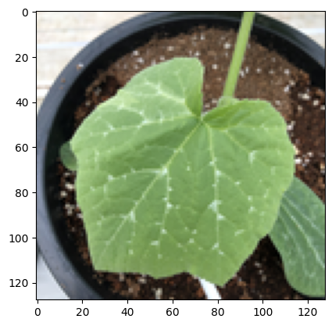
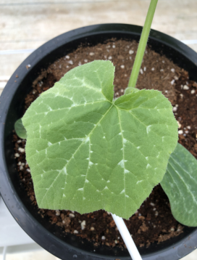
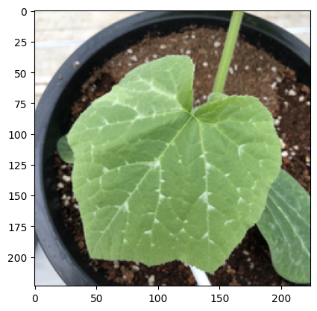
Data Preprocessing & Anti-Aliasing
def resize_and_crop(img_array,size):
img = Image.fromarray(image_array)
img_ratio = img.size[0] / img.size[1]
ratio = size[0] / size[1]
if ratio > img_ratio:
img = img.resize((size[0], int(round(size[0] * img.size[1] /
img.size[0]))), Image.LANCZOS)
box = (0, int(round((img.size[1] - size[1]) / 2)), img.size[0],
int(round((img.size[1] + size[1]) / 2)))
img = img.crop(box)
elif ratio < img_ratio:
img = img.resize((int(round(size[1] * img.size[0] / img.size[1])),
size[1]), Image.LANCZOS)
box = (int(round((img.size[0] - size[0]) / 2)), 0,
int(round((img.size[0] + size[0]) / 2)), img.size[1])
img = img.crop(box)
else :
img = img.resize((size[0], size[1]), Image.LANCZOS)
return img
Original
(3024x4028)
Resize
(128x128)
정확도 : 97,6 % , 모델학습 시간 : 416초, GPU RAM(V100) : 4.4GB/16GB
Resize
(224x224)
정확도 : 98.9% , 모델학습 시간 : 600초, GPU RAM(V100) : 8.4GB/16GB

Slide 22
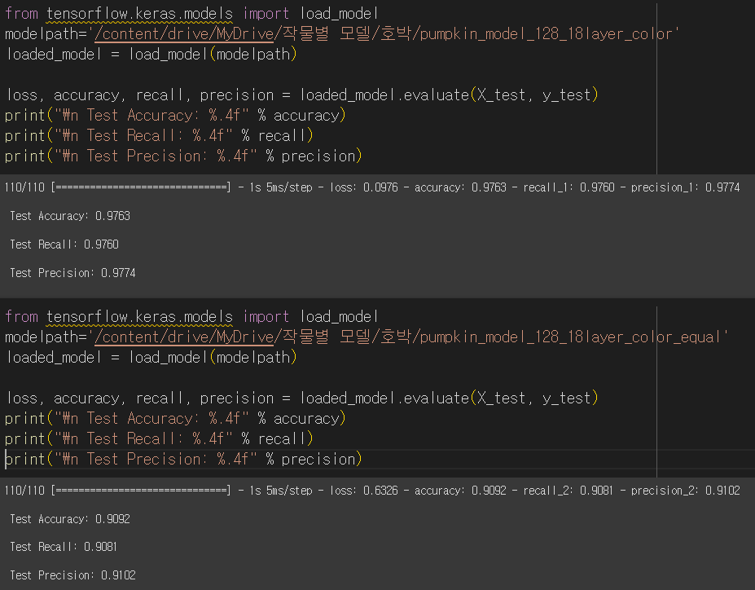
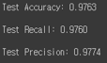
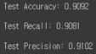
Model
Performance Comparison

Slide 23
Data Preprocessing
## 호박
normal = np.load('/content/drive/MyDrive/데이터/호박/train/호박_정상_224_color.npy')
disease = np.load('/content/drive/MyDrive/데이터/호박/train/호박_질병_224_color.npy')
expend = np.load('/content/drive/MyDrive/데이터/호박/train/호박_증강_224_color.npy')
diseases = np.concatenate((disease, expend), axis=0)
X_train2 = np.concatenate((normal, diseases), axis=0)
labels = pd.read_csv('/content/drive/MyDrive/데이터/호박/train/[라벨]호박.csv＇)
If X_train2.shape[0]==labels.shape[0] :
y_train = labels.loc[:,＇disease＇]
else :
print(＇길이가 같지 않습니다.＇)
np.unique(y_train)
y_train[y_train==19]=1
y_train[y_train==20]=2
## 배추
normal = np.load('/content/drive/MyDrive/데이터/배추/train/배추_정상_224_color.npy')
disease = np.load('/content/drive/MyDrive/데이터/배추/train/배추_질병_224_color.npy')
expend1 = np.load('/content/drive/MyDrive/데이터/배추/train/배추_증강(1)_224_color.npy')
expend2 = np.load('/content/drive/MyDrive/데이터/배추/train/배추_증강(2)_224_color.npy’)
expend = np.concatenate((expend1, expend2), axis=0)
diseases = np.concatenate((disease, expend), axis=0)
X_train2 = np.concatenate((normal, diseases), axis=0)
labels = pd.read_csv('/content/drive/MyDrive/데이터/배추/train/[라벨]배추.csv’)
if X_train2.shape[0]==labels.shape[0] :
y_train = labels.loc[:,'disease']
else :
print('길이가 같지 않습니다.')
np.unique(y_train)
y_train[y_train==5]=1
y_train[y_train==6]=2

Slide 24
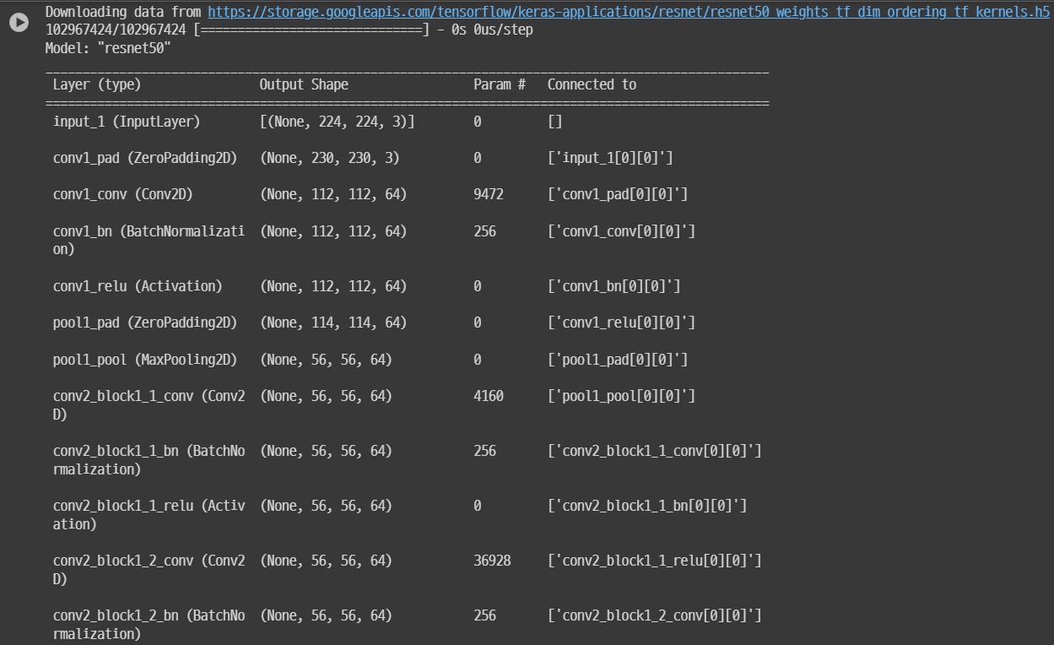


Model
resnet = ResNet50(weights='imagenet')
resnet.summary()
json_string = resnet.to_json()
with open("model.json", "w") as f :
f.write(json_string)
def input_layer(x):
x = ZeroPadding2D(padding=(3, 3))(x) ## 230x230x3
x = Conv2D(64, (7, 7), strides=(2, 2))(x) ## 112x112x64
x = BatchNormalization()(x)
x = Activation('relu')(x)
x = ZeroPadding2D(padding=(1,1))(x) ## 114x114x64
x = MaxPooling2D((3, 3), 2)(x) ## 56x56x64
return x

Slide 25
Model
def conv_layer1(x, out, layer):
shortcut = x
for i in range(layer):
if(I == 0):
x = Conv2D(out//4, (1, 1), strides=(1, 1), padding=‘valid')(x)
x = BatchNormalization()(x)
x = Activation('relu')(x)
x = Conv2D(out//4, (3, 3), strides=(1, 1), padding=‘same')(x)
x = BatchNormalization()(x)
x = Activation('relu')(x)
x = Conv2D(out, (3, 3), strides=(3, 3), padding=‘valid')(x)
shortcut = Conv2D(out, (1, 1), strides=(1, 1),
padding=‘valid’)(shortcut)
x = BatchNormalization()(x)
shortcut = BatchNormalization()(shortcut)
x = Add()([x, shortcut])
x = Activation('relu')(x)
shortcut = x
else:
x = Conv2D(out//4, (1, 1), strides=(1, 1), padding=‘valid')(x)
x = BatchNormalization()(x)
x = Activation('relu')(x)
x = Conv2D(out//4, (3, 3), strides=(1, 1), padding=‘same')(x)
x = BatchNormalization()(x)
x = Activation('relu')(x)
x = Conv2D(out, (1, 1), strides=(1, 1), padding=‘valid')(x)
x = BatchNormalization()(x)
x = Add()([x, shortcut])
x = Activation('relu')(x)
shortcut = x
return x
(2, 2)

Slide 26



Model
def resnet50():
inputs = Input(shape=(224, 224, 3))
x = input_layer(inputs) # 56 x 56 x 64
x = conv_layer1(x,64, 3) # 56 x 56 x 64
x = conv_layer2(x,128, 4) # 28 x 28 x 128
x = conv_layer2(x,256, 6) # 14 x 14 x 256
x = conv_layer2(x,512, 3) # 7 x 7 x 512
x = GlobalAveragePooling2D()(x) # 1 x 1 x 512
x = Dense(1000)(x)
output_tensor = Dense(3, activation='softmax')(x)
model = Model(inputs=inputs, outputs=output_tensor)
return model
def resnet18():
inputs = Input(shape=(224, 224, 3))
x = input_layer(inputs)
x = conv_layer1(x,64, 2)
x = conv_layer2(x,128, 2)
x = conv_layer2(x,256, 2)
x = conv_layer2(x,512, 2)
x = GlobalAveragePooling2D()(x)
x = Dense(1000)(x)
output_tensor = Dense(3, activation='softmax')(x)
model = Model(inputs=inputs, outputs=output_tensor)
return model

Slide 27


Model
Error rate according to epoch

Slide 28
INDEX
Model
(DeepLearning)
Reason
Q&A
Design Specification
Web Service

Slide 29

Web
Django
It is a Python-based high-level web framework that supports fast and safe web development using MVT (Model-View-Template) architecture
• ORM (Object-Relational Mapping): Database management is handled with Python code
• Automatic administrator page: Provides an automatically created administrator page for database management
• URL pattern and view processing: Easy support for URL mapping and view
processing

Slide 30

Web
DB design

Slide 31

Web
## 2. Crop Diagnosis
def analysis(request):
imgname = ''
# 예시에 따라 이미지 선택
example = request.GET.get('example', None)
if example:
if example == 'ex1':
filepath = STATICFILES_DIRS[3]
imgname = 'cabbage_ex1.jpg'
elif example == 'ex2':
filepath = STATICFILES_DIRS[3]
imgname='cabbage_ex2.jpg'
elif example == 'ex3’:
filepath = STATICFILES_DIRS[3]
imgname='cabbage_ex3.jpg'
elif 'img' in request.FILES:
# 직접 업로드한 이미지 사용
uploadimg = request.FILES['img']
imgname = uploadimg._name
fp = open('%s%s' % (STATICFILES_DIRS[2], uploadimg), 'wb’)
for temp in uploadimg.chunks():
fp.write(temp)
fp.close()
filepath = STATICFILES_DIRS[2]
# 전처리
x_predict = preprocessing(filepath, imgname)
x_predict = x_predict.astype(np.float32)
# 모델에 분석 요청
model = tf.saved_model.load(MODEL_DIRS[1])
# 추론 (예측)
inference = model.signatures["serving_default"]
y_predict = inference(tf.constant(x_predict))
y_predict = y_predict['dense_1'].numpy()

Slide 32
Web
## 2. Crop Diagnosis
# 결과 출력
print("Predictions:", y_predict)
# 정상 확률
good = round(y_predict[0][0]*100, 2)
bad1 = round(y_predict[0][1]*100, 2)
bad2 = round(y_predict[0][2]*100, 2)
if request.session.get('sessionid') is not None and 'img' in request.FILES:
userid = request.session['sessionid']
category = '양배추'
if good >= 80:
condition = '정상'
elif good >= 50:
if bad1 > bad2:
condition = '정상-균핵병가능'
elif bad2 > bad1:
condition = '정상-무름병가능'
else:
if bad1>bad2:
condition = '균핵병'
elif bad2>bad1:
condition = '무름병'
Crop.objects.create(userid=userid, category=category, condition=condition, imgname=imgname)
ctx = {
'result': y_predict,
'good':good,
'bad1':bad1,
'bad2':bad2,
'filepath': filepath,
'imgname':imgname,
'settings':settings,}
return render(request, 'output/cabbage_out.html', ctx)
############################################

Slide 33


Web
Cabbage & Bean

Slide 34


Web
Green Onion & Radish

Slide 35


Web

Slide 36




Web
Result & Benefit
Web
Agricultural automatic

Slide 37
INDEX
Model
(DeepLearning)
Reason
Q&A
Design Specification
Web Service

Slide 38
Q&A

